Slide 1
Reading the Fine Points of the GRFP Solicitation
GRF Operations Center September 29, 2021

Slide 2
Overview
Common Questions We Receive
Level Types | Number of Times You Can Apply
Previous Graduate School Experience
Joint BS/MS Eligibility
Professional Degrees
Citizenship/DACA
Questions YOU Should Research

Slide 3
Program Solicitation
Access to current solicitation:
https://www.nsf.gov/pubs/2021/nsf21602

Slide 4
Online Eligibility Questionnaire
Access the questionnaire:
www.nsfgrfp.org

Slide 5
Major Fields of Study
Selection of a major field of study determines the application deadline, the broad disciplinary expertise of the reviewers who will review the application, and the discipline of the graduate program if the fellowship is excepted. This subfield category designates specific expertise of the reviewers. Applicants can select “other” if their specific subfield is not represented in the list of subfields under the major field of study.
Chemistry
Computer and Information Sciences and Engineering
Engineering
Geosciences
Life Sciences
Materials Research
Mathematical Sciences
Physics and Astronomy
Psychology
Social Sciences
Stem education and Learning Research

Slide 6
Levels Defined
Undergraduates in their final year
Those who have earned a bachelors degree
Individuals not previously enrolled in a graduate degree granting program
First you graduate students who have never replied to the GRFP is it any of the following:
Previous graduate student
Returning graduate student
Students currently enrolled in a joint bachelor’s- master’s degree program
Individuals who have completed no more than one academic year of graduate study (while enrolled in a program)
Those who do not have a graduate degree
Graduate / returning students who have never applied to the GRFP
Returning graduate students who:
Have had an interruption of two or more years (prior to the deadline)
Are not currently enrolled in a degree granting program
1
3
2
4

Slide 7
Number of Times You Can Apply
Level 1 -> Unlimited (per cycle)
Includes:
Undergraduate students
Individuals who are bachelorette holders who have yet to pursue graduate studies
Levels 2-4 -> Once
Includes:
Enrolled in a graduate degree granting program
Individuals returning to graduate school

Slide 8
#1 Previous Graduate Experience
Applicants must have never earned a master's or professional degree in any field, or completed more than one academic year in a graduate degree-granting program as indicated in the academic transcript, unless
(i) returning to graduate study after an interruption of 2 or more consecutive years immediately preceding the application deadline, AND;
(ii) are not enrolled in a graduate degree program at the application deadline.
Graduate coursework that was taken without being enrolled in a graduate degree-granting program does not count toward the one-year limit.
There are NO exceptions for degrees earned from foreign institutions.
There are NO exceptions for degrees earned in non-related fields.

Slide 9
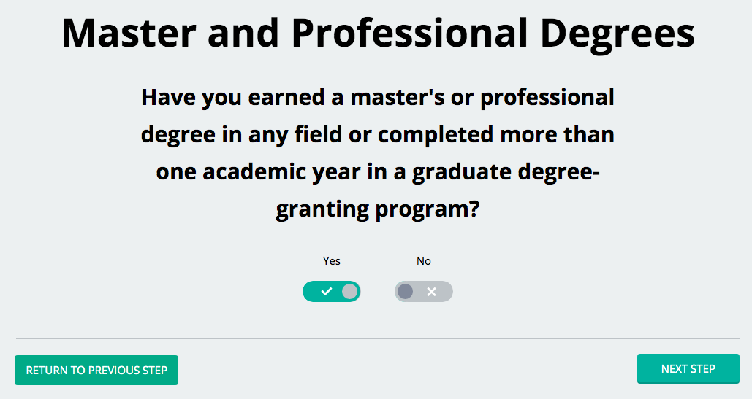
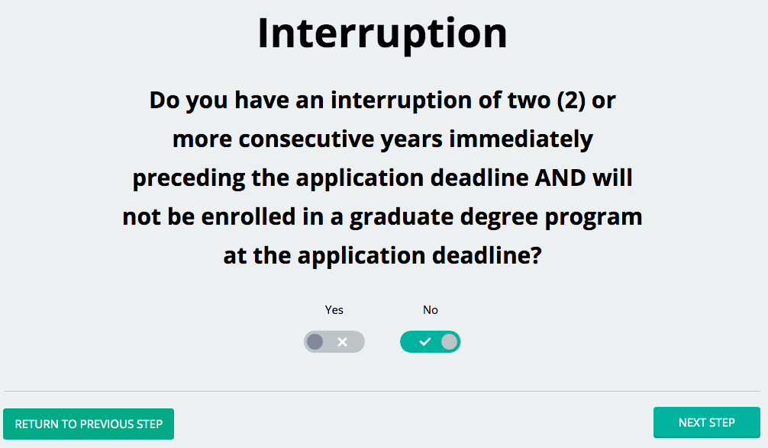
#2 Previous Graduate Experience
https://www.nsfgrfp.org/applicants/fellowship-eligibility

Slide 10
Joint BS / MS Eligibility
Individuals pursuing a joint bachelor's-master's degree are considered to be graduate students and are limited to one application.
These individuals can apply EITHER while enrolled in the joint degree program OR as first-year doctoral students shortly after completion of the joint degree.
All applicants in joint bachelor's-master's degree programs must have completed three years in the joint program as of the application deadline.
If you did not progress directly to a doctoral program, you will not be eligible unless you have had a continuous interruption of at least two consecutive years immediately prior to the application deadline AND are not enrolled in a degree-granting graduate program at the application deadline.

Slide 11
Professional Degree
The GRFP only supports research based STEM or STEM Education programs. Programs that do not require a thesis and are categorized as Professional Degrees will therefore not be considered. Examples of Practice Oriented Professional Degrees (dual degrees are considered the same as any of the below):
MBA
MPH
MSW
JD
MD
DMV
DDS
For more guidance regarding eligible degree programs/field of study please contact your academic advisor, PI or registrar.

Slide 12
#1 Citizenship
What is Citizenship defined as?
Permanent resident
Nationals
A native resident of a commonwealth or territory of the United States
United States Citizen
Not considered under Citizenship:
Student under a Visa
DACA recipient
Individuals who have applied for US citizenship and have not been granted by the application deadline.

Slide 13
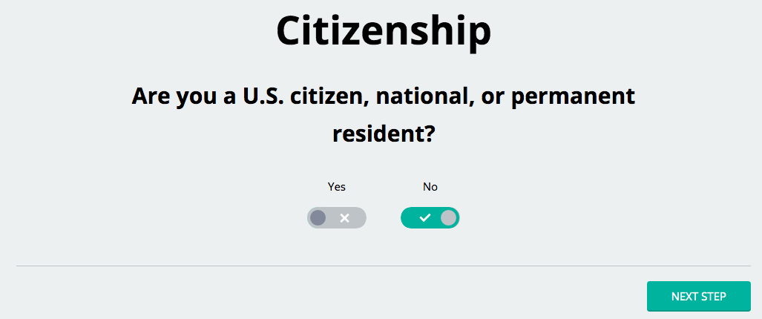
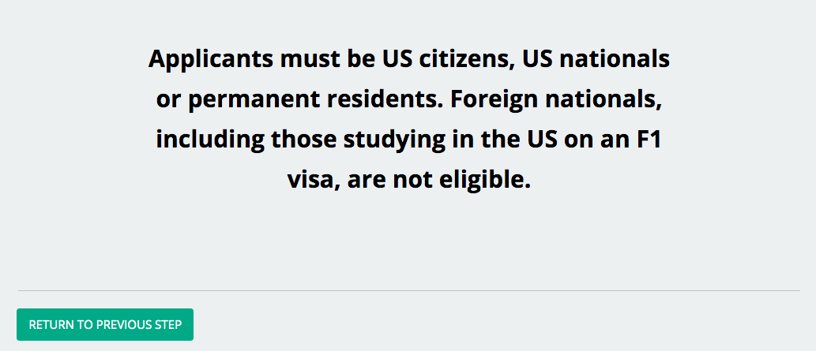
#2 Citizenship

Slide 14
Where to Find Answers
The GRFP Help Desk is one of many resources available to applicants. The GRFP Help Desk however is limited in the areas of :
Field of Study & Proposed Research
Technical Issues
Third Party Inquiries (someone inquiring on behalf of the applicant)
Other Resources:
For individuals needing assistance on the Field of Study/ Proposed research sections, please contact your academic advisor, PI, Coordinating Official, or mentor.
For technical assistance, please contact NSF Fastlane

Slide 15
#1 Helpful Resources for Applicants
Current Solicitation
(https://www.nsf.gov/pubs/2021/nsf21602/nsf21602.htm)
FAQs
(https://www.nsf.gov/publications/pub_summ.jsp?ods_key=nsf21109)
Application Components
(https://www.nsfgrfp.org/applicants/application-components/)
Application Module
(https://www.research.gov/grfp/Login.do)

Slide 16
#2 Helpful Resources for Applicants
Current Solicitation
(https://www.nsf.gov/pubs/2021/nsf21602/nsf21602.htm)
Go to www.nsfgrfp.org/applicants
Scroll down the blue panel on the left side of the screen and click on GRF Program Solicitation
Click on the GRF Program Solicitation

Slide 17
#3 Helpful Resources for Applicants
Current Solicitation
(https://www.nsf.gov/pubs/2021/nsf21602/nsf21602.htm)
Select the HTML or PDF version of the program solicitation
NOTE: All applicants should read the current GRF Program Solicitation before they start their GRFP application. The GRF Program Solicitation contains important information about application terms and conditions, eligibility requirements, application instructions, and the Merit Review Criteria.

Slide 18
#4 Helpful Resources for Applicants
FAQs
(https://www.nsf.gov/pubs/2021/nsf21602/nsf21602.htm)
Go to www.nsfgrfp.org/applicants
Scroll down the blue panel on the left side of the screen and click on FAQs
Select either the program FAQs or the technical FAQs

Slide 19
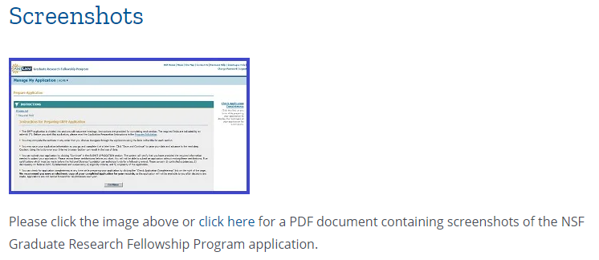
#5 Helpful Resources for Applicants
Application Components
(https://www.nsfgrfp.org/applicants/application-components/)
Go to www.nsfgrfp.org/applicants
Scroll down the blue panel on the left side of the screen and click on Application Components to access a PDF of screenshots of each component

Slide 20
#6 Helpful Resources for Applicants
Application Components
(https://www.nsfgrfp.org/applicants/application-components/)
OR you can click on each of the components in the blue panel

Slide 21
#7 Helpful Resources for Applicants
Application Module (https://www.research.gov/grfp/Login.do)
Go to www.nsfgrfp.org/applicants
Scroll down the blue panel on the left side of the screen and click on GRF Application
Click on the word here to access the Fastlane Application Module

Slide 22
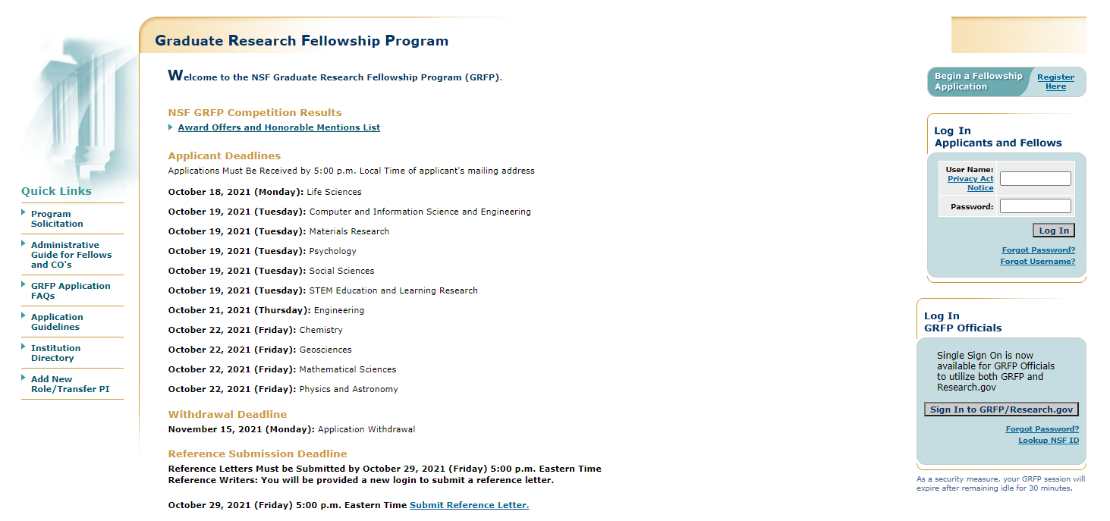
#8 Helpful Resources for Applicants
Application Module (https://www.research.gov/grfp/Login.do)

Slide 23
Contact
An official eligibility determination can only be made from a complete submitted application.
Take the self-eligibility questionnaire at html://www.nsfgrfp.org.
EMAIL: info@nsfgrfp.org
PHONE: 866.673.4737

