Slide 1
GRFP Title Slide
Graduate Research Fellowship Program (GRFP)
NSFGRFP.org
EDUCATION AND HUMAN RESOURCES DIRECTORATE (EHR)
DIVISION OF GRADUATE EDUCATION (DGE)

Slide 2
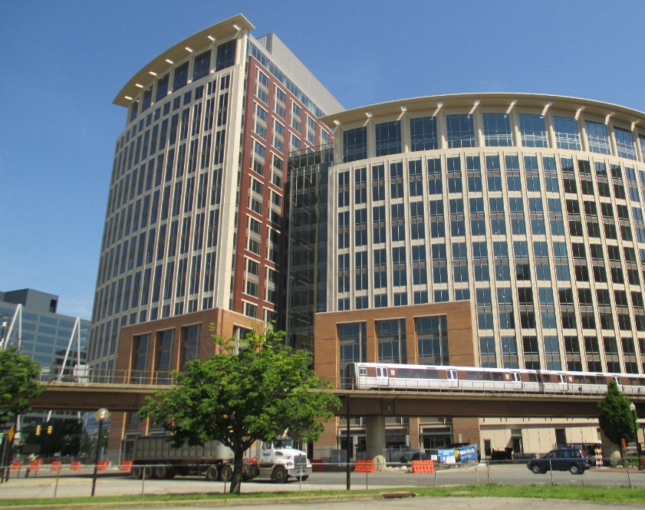
Graduate Research Fellowship Program (GRFP)
Education and Human Resources (EHR)
Division of Graduate Education (DGE)
www.nsf.gov/grfp
info@nsfgrfp.org
www.nsfgrfp.org

Slide 3
GRFP Infographic
Fellows from every state
Each major field has numerous sub-fields

Slide 4
GRFP Goals
The overall goal of the Graduate Research Fellowship Program is to recruit individuals into Science, Technology, Engineering, and Mathematics (STEM) fields
To select, recognize, and financially support individuals who have demonstrated the potential to be high achieving scientists and engineers, early in their careers
To broaden participation in science and engineering of underrepresented groups, including women, minorities, persons with disabilities, and veterans

Slide 5
National Science Foundation
Graduate Research Fellowship Program
(GRFP)
ELIGIBILITY

Slide 6
GRFP Eligibility - NSF 21-602
U.S. citizens, nationals, and permanent residents
Early-career: undergrad & graduate students
Pursuing research-based master’s and/or doctoral degrees (no professional degrees)
Science, Technology, Engineering, Mathematics (STEM) or STEM Education
Full-time enrollment in graduate degree program at accredited, non-profit US institution of higher education
NO foreign institutions
Level 1: Seniors/bachelor's degree: no graduate study
Level 2: 1st-year graduate students
Joint bachelor’s-master’s (completed 3 years)
Level 3: Second-year graduate students
No more than 1 academic year completed in 1st graduate degree program
For joint BS/MS holders ONLY, can apply as 1st year doctoral students if went directly into PhD program, after completing joint bachelor’s-master’s degree)
Level 4: Returning graduate students
> 2-year interruption in graduate study
No doctorates or >1 academic year in graduate program
NOT ENROLLED in graduate program at application deadline
Only apply once in grad school
6

Slide 7
Ineligible Degree Programs
Professional degree programs
E.g., MBA, MD, JD, DVM, DDS
Joint science-professional degree programs
E.g., MD/PhD, JD/PhD
Community, Global, or Public Health (MPH)
Counseling, Social Work (MSW)
Education (except STEM education)
History (except history of science)
See Detailed Eligibility Requirements in the GRFP Solicitation

Slide 8
Ineligible Fields of Study
Research with directly health-related goals
Etiology, diagnosis, or treatment of disease or disorder
Animal models of disease for drug development/testing
Epidemiology
Disease prevention
Public, community, global health
Clinical research
Patient-oriented research
Epidemiological and behavioral studies
Outcomes research
Health services, standard of care, health policy
Research directly leading to clinical trials
Applied research on plant pathology
Maximizing agricultural production
Impacts on food safety

Slide 9
Example GRFP Application Timeline
Shortly after application is due
Late October
For Level 1 only
Applications Due
Reference Letters Due
Apply to Grad Schools!
Fellowship Offers
Acceptance of Award and Declaration of Tenure/Reserve
Fellowship Year Begins
March – April
Early May
Early September

Slide 10
GRFP
nsfgrfp.org/reviewers
Graduate Research Fellowship Program
Division of Graduate Education (DGE)
www.nsf.gov/grfp
info@nsfgrfp.org
www.nsfgrfp.org

