Slide 1
Division of Graduate Education (DGE) Graduate Research Fellowship Program (GRFP) NSFGRFP.org
Notes:
The Division of Graduate Education (DGE) advocates for innovative, inclusive, high quality graduate education in the STEM (Science, Technology, Engineering, and Mathematics) fields.
DGE manages innovative cross-Foundation programs that directly or indirectly support U.S. citizens and permanent residents in their quest to become the leading scientists and engineers of the future.
To better inform its programs, DGE supports research and other activities that will generate exciting new ideas for the graduate education of the future.

Slide 2
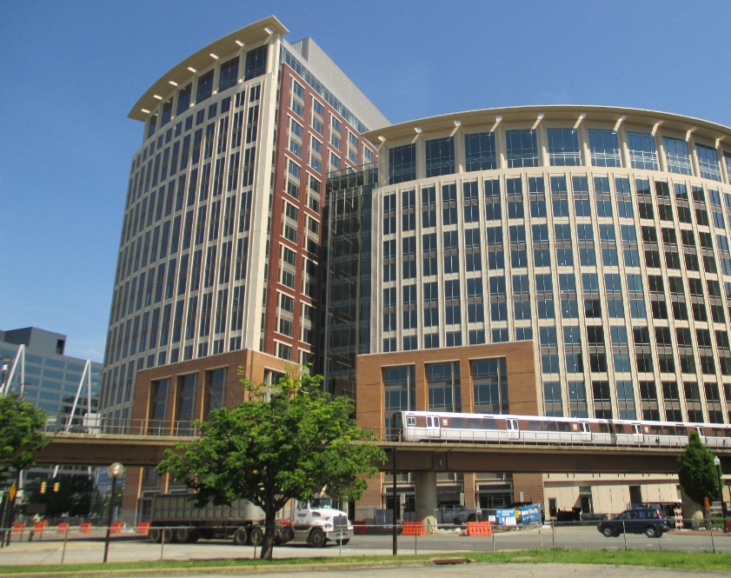
Graduate Research Fellowship Program (GRFP)
Directorate of STEM Education (EDU)
Division of Graduate Education (DGE)
www.nsf.gov/grfp
info@nsfgrfp.org
www.nsfgrfp.org

Slide 3
General Information
Description
Talk Contents
Eligibility
About GRFP
Ineligible Degree Programs
Ineligible Fields of Study
Application Package
Review Criteria

Slide 4
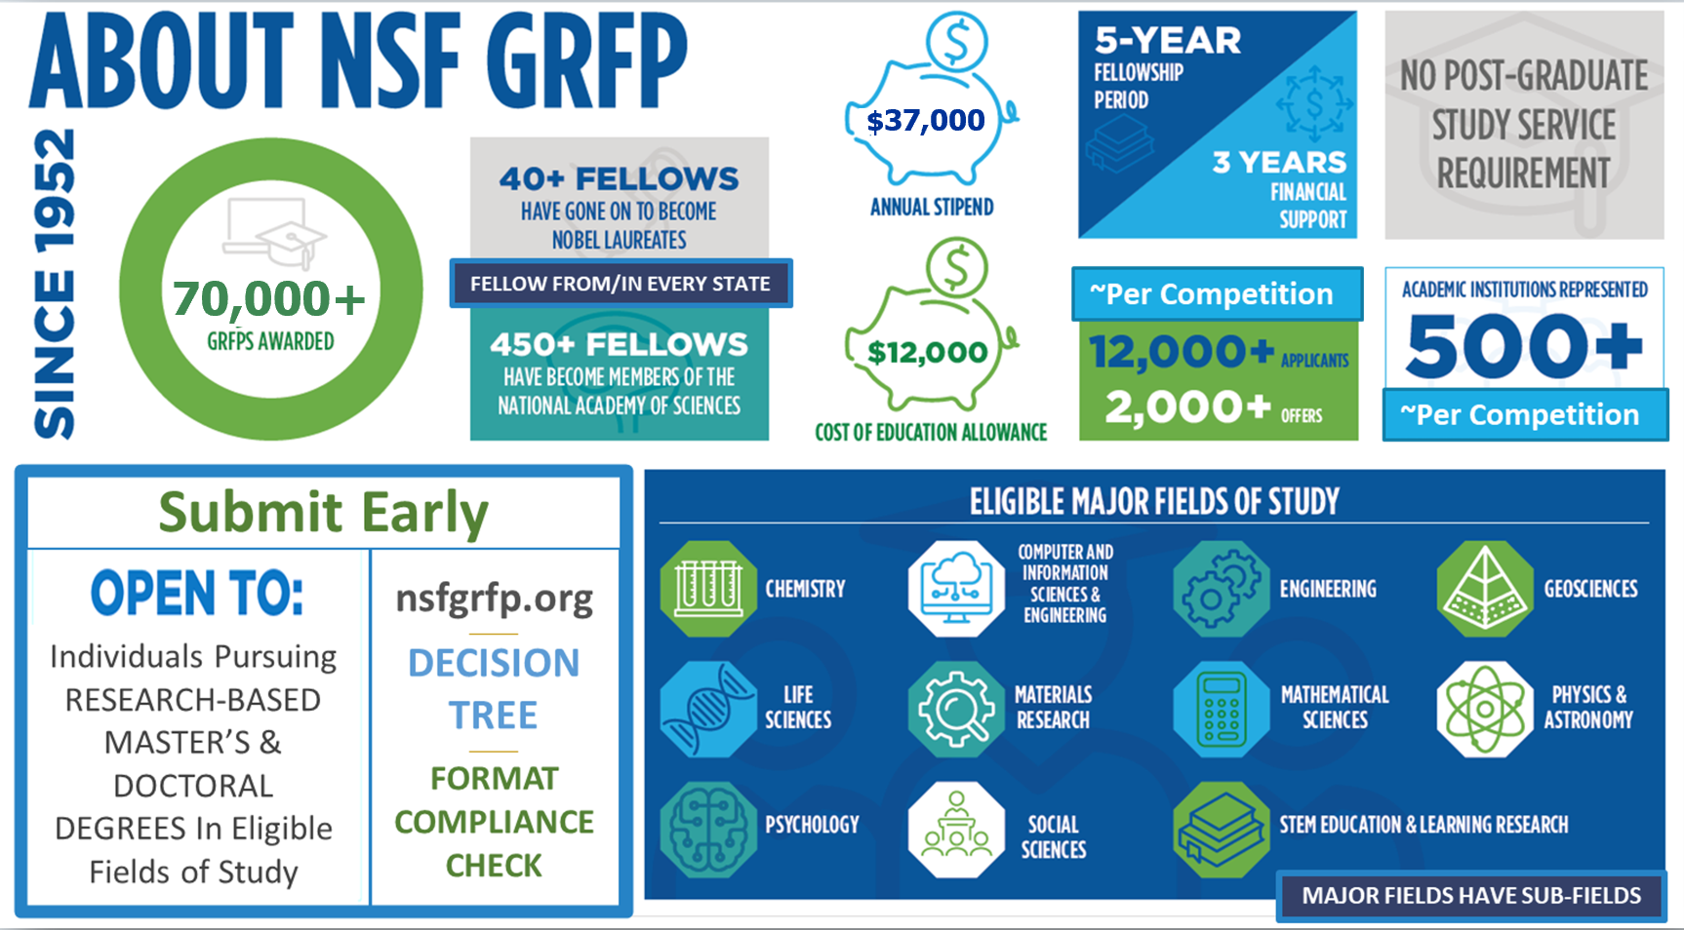
About NSF GRFP

Slide 5
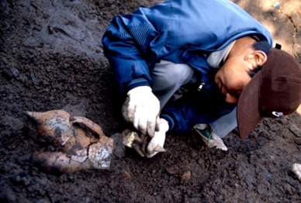
National Science Foundation
Graduate Research Fellowship Program (GRFP)
DESCRIPTION

Slide 6
NSF Graduate Research Fellowships
Five Year Awards – $147,000*
Three years of financial support
$37,000 stipend each year to the graduate institution
$12,000 educational allowance directly to graduate institution
In lieu of tuition (paid by institution) and fees
Other NSF Opportunities
INTERN – non-academic internship program
FASED Individuals with Disabilities support
Career-Life Balance Initiative (family leave)
*Amounts are based on GRFP Solicitation NSF 22-614and subject to the availability of funds

Slide 7
GRFP Benefits
Fellowship: Awarded to individual, paid through the attended graduate institution
Flexible: Choice of project, advisor, and graduate program
Unrestricted: No service requirement after completion
Portable: Can be used at any accredited, non-profit, US institution of higher education, with campus in US research-based master’s and doctoral degrees
2010 - 2021: ~2,000 Fellowships yearly
2021: ~12,600 Applications - ~17% success rate
2020: ~12,800 Applications - ~16% success rate
2019: ~12,200 Applications - ~16% success rate
2018: ~12,400 Applications - ~16% success rate

Slide 8
GRFP Goals
The overall goal of the Graduate Research Fellowship Program is to recruit individuals into Science, Technology, Engineering, and Mathematics (STEM) fields
To select, recognize, and financially support individuals who have demonstrated the potential to be high achieving scientists and engineers, early in their careers
To broaden participation in science and engineering of underrepresented groups, including women, minorities, persons with disabilities, and veterans

Slide 9
NSF GRFP
Graduate Research Fellowship Program
(GRFP)
ELIGIBILITY

Slide 10
GRFP Eligibility – NSF Solicitation 22-614
U.S. citizens, nationals, and permanent residents
Early-career: undergrad & graduate students
Pursuing research-based master’s and/or doctoral degrees (no professional degrees)
Science, Technology, Engineering, Mathematics (STEM) or STEM Education
Full-time enrollment in graduate degree program at accredited, non-profit US institution of higher education
NO foreign institutions
Level 1: Seniors/bachelor's degree: no graduate study
Level 2: 1st-year graduate students
Joint bachelor’s-master’s (completed 3 years)
Level 3: Second-year graduate students
No more than 1 academic year completed in 1st graduate degree program
For joint BS/MS holders ONLY, can apply as 1st year doctoral students if went directly into PhD program, after completing joint bachelor’s-master’s degree)
Level 4: Returning graduate students
> 2-year interruption in graduate study
No doctorates or >1 academic year in graduate program
NOT ENROLLED in graduate program at application deadline
Only apply once
10

Slide 11
Ineligible Degree Programs
Professional degree programs
E.g., MBA, MD, JD, DVM, DDS
Joint science-professional degree programs
E.g., MD/PhD, JD/PhD
Community, Global, or Public Health (MPH)
Counseling, Social Work (MSW)
Education (except STEM education)
History (except history of science)
See Detailed Eligibility Requirements in the GRFP Solicitation

Slide 12
Ineligible Fields of Study
Research with directly health-related goals
Etiology, diagnosis, or treatment of disease or disorder
Animal models of disease for drug development/testing
Epidemiology
Disease prevention
Public, community, global health
Clinical research
Patient-oriented research
Epidemiological and behavioral studies
Outcomes research
Health services, standard of care, health policy
Research directly leading to clinical trials
Applied research on plant pathology
Maximizing agricultural production
Impacts on food safety

Slide 13
Graduate Research Fellowship Program (GRFP)
Application Package

Slide 14
GRFP Application
Complete Application Package:
Personal Information, Education, Work/Research Experience, Proposed Major Field of Study, Honors, Awards, Publications
Personal, Relevant Background and Future Goals Statement (3-page PDF)
Graduate Research Statement (2-page PDF)
Transcripts (PDFs; mandatory)
Letters of reference (may provide up to five names of reference letter writers)
3 reference letter writer names are mandatory and 2 reference letters are mandatory for application review

Slide 15
GRFP Application Specifics
DEADLINES (5 p.m. local applicant mailing address):
Oct. --, 2023: Life Sciences
Oct. --, 2023: CISE, Materials Research, Psychology, Social Sciences, STEM Education and Learning
Oct. --, 2023: Engineering
Oct. --, 2023: Chemistry, Geosciences, Math, Physics & Astronomy
Read the GRFP Solicitation for detailed application instructions and requirements
If accessibility accommodations are required, please contact info@nsfgrfp.org at least four weeks before the application deadline

Slide 16
Example GRFP Application Timeline
Shortly after application is due
Late October
For Level 1 only
Applications Due
Reference Letters Due
Apply to Grad Schools!
Fellowship Offers
Acceptance of Award and Declaration of Tenure/Reserve
Fellowship Year Begins
March – April
Early May
Early September

Slide 17
1) Personal, Relevant Background & Goals 2) Research Statement
Graduate Research Fellowship Program (GRFP)
Two Statements

Slide 18
Personal, Relevant Background & Goals
Tell your story; demonstrate your potential for STEM research
Experiences (professional and personal) that contributed to your motivation and preparation for pursuing a STEM career
Career aspirations and future goals
How have your experiences shaped your goals?
Research, industrial, professional experience
What was the project, what was your role?
How did you become involved? Where was it done?
Why was this project worth doing? What have you learned? Any advanced course work?
What was your contribution to the project and how did it fit into the whole?
18

Slide 19
Research Statement
Describe your proposed research plan:
Communicate your research idea and approach
Explain your research plan and methods
What do you expect to learn? How will you know if the project is successful?
What would you do next?
Keep in mind:
Avoid jargon
Communicate clearly for non-specialists
Make your contributions clear
Clearly address NSF’s Merit Review Criteria – Intellectual Merit and Broader Impacts – under separate headings
19

Slide 20
Reference Letters and Transcripts
Reference Letters – Before the Deadline
MANDATORY for Application Review
3 names must be listed as part of the application
2 reference letters must be received by NSF
STRONGLY RECOMMENDED
Up to 5 names of potential references can be listed
3 reference letters received by NSF
Applicants list and rank up to 5 reference letter writers - Top 3 will be seen by reviewers
Transcripts – Required
All applicants must submit bachelor’s degree transcript
Transcripts are required for all degree-programs
Transcripts required for all graduate degree enrollment
Official or unofficial transcripts accepted

Slide 21
Graduate Research Fellowship Program (GRFP)
Review Criteria

Slide 22
Comprehensive Review National Science Board Merit Review Criteria
Intellectual Merit
How important is the proposed activity to advancing knowledge within its own field or across different fields?
Broader Impacts
How well does the proposed activity benefit society or advance desired societal outcomes?

Slide 23
Comprehensive Review
Applicants are reviewed based on:
Their demonstrated potential for significant achievement in STEM
Using a comprehensive, holistic approach
A balanced consideration to all components of the application
Including the educational and research record, leadership, outreach, service activities, plans for the future, individual competencies, experiences, and other attributes

Slide 24
Intellectual Merit
Potential to advance knowledge
Evidence of potential, such as ability to:
Demonstrated intellectual ability (grades, curricula, awards, publications, presentations, etc.)
Plan and conduct research
Work as a member of a team as well as independently
Interpret and communicate research
Take initiative, solve problems, persist
The potential of your approach to your major field of study and your Research Plan to advance knowledge
Evidence of Intellectual Merit can be found in all parts of the application: Personal Statement, Research Plan, letters, experiences, awards, achievements, and transcripts
24

Slide 25
Broader Impacts
Potential impact of the individual and/or the research on society; why it’s important
Societal benefits may include, but are not limited to:
Increasing participation of underrepresented groups, women, persons with disabilities, veterans
Outreach: Mentoring; improving STEM education in schools
Increasing public scientific literacy; increased public engagement with STEM
Community outreach: science clubs, radio, TV, newspapers, blogs
Increasing collaboration between academia, industry, others
Evidence of Broader Impacts can be in all parts of the application: Personal Statement, Research Plan, letters, experiences, awards, achievements
25

Slide 26
Thank you
nsfgrfp.org/reviewers
Graduate Research Fellowship Program (GRFP)
Program Contacts
GRFP Reference Writers: nsfgrfp.org/reference_writers
GRFP Reviewers: nsfgrfp.org/reviewers/
info@nsfgrfp.org
www.nsf.gov/grfp & www.nsfgrfp.org
866-NSF-GRFP, 866-673-4737 (toll-free from the US & Canada)
202-331-3542 (international)

